Slide 1
edufree WEB PAGE FOR multiple intervenant in the education system
Crococoder 2022
Full stack JS 2nd project
By oussama essaidi

Slide 2

Principal pagers

Slide 3
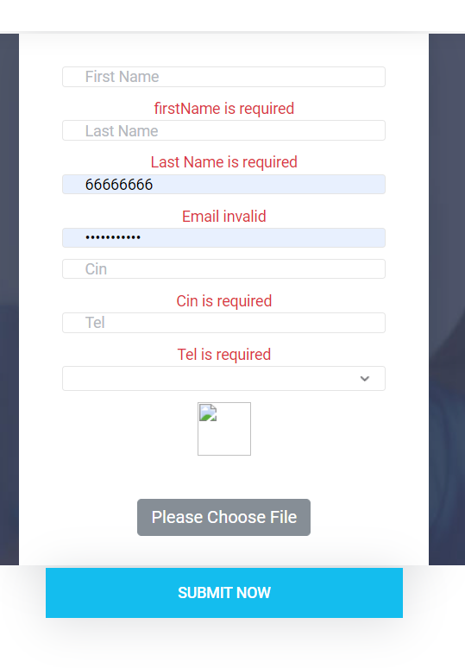
Signup student

Slide 4
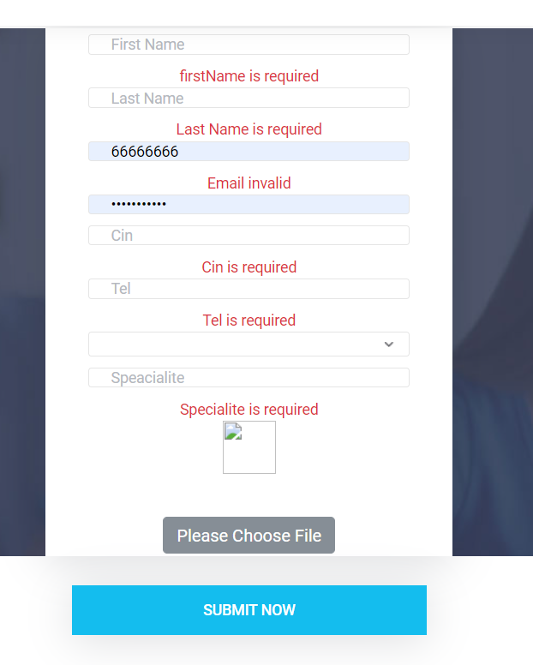
Signup-teacher

Slide 5
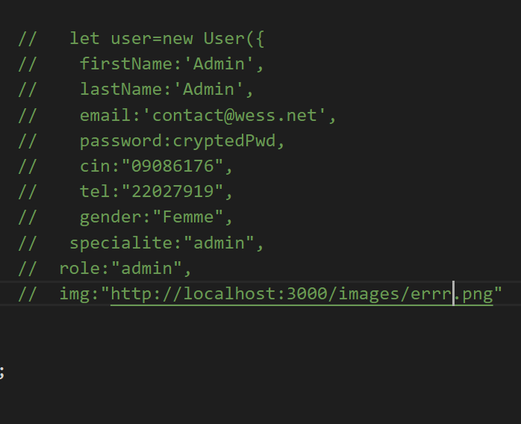
Signup-admin
Pour l’admin j’ai affecter un email et un mot de passe qui vont étre changer par lui méme

Slide 6
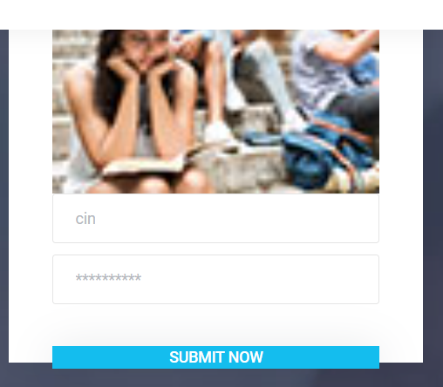
Login

Slide 7
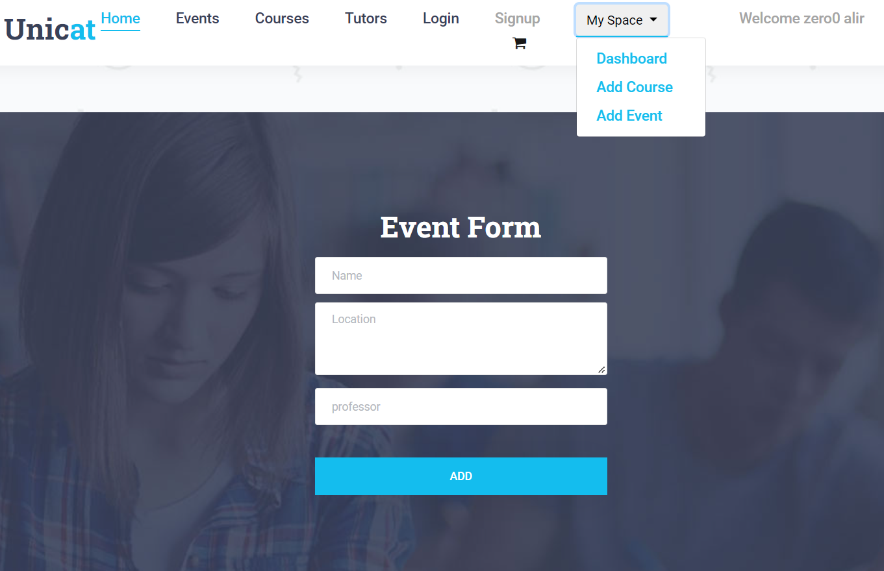
teacher

Slide 8

Dashboard teacher

Slide 9
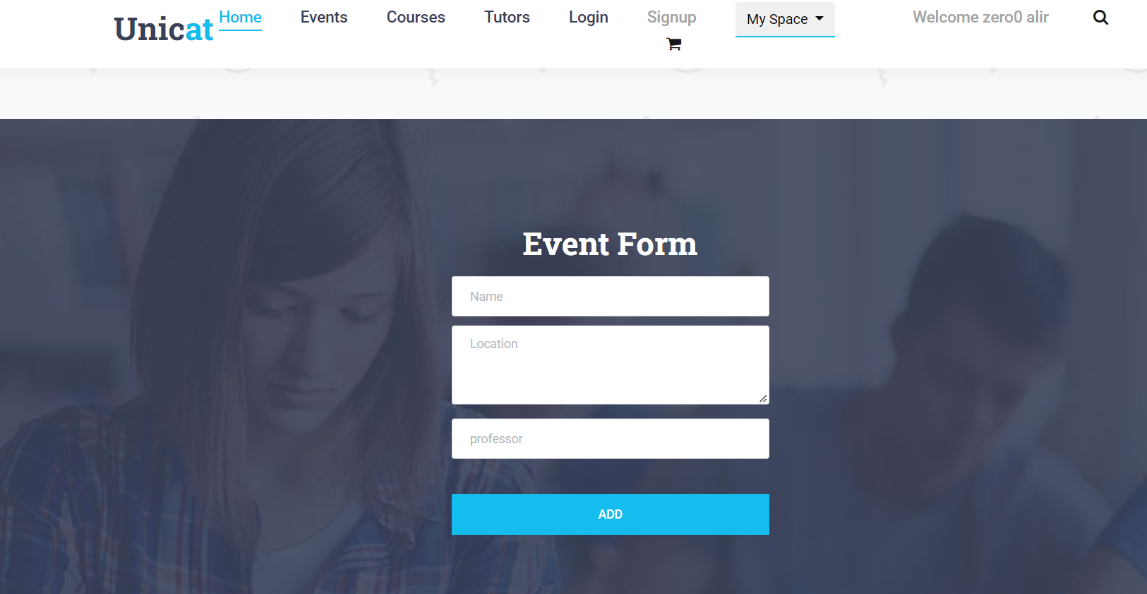
add event

Slide 10
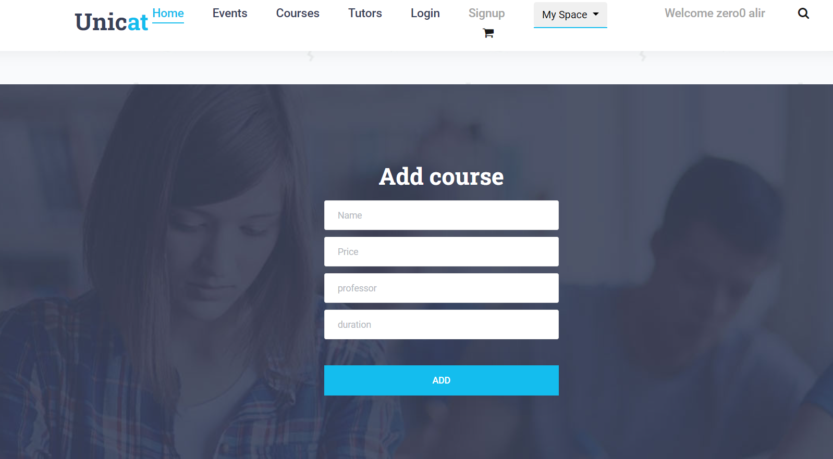
Add courses

Slide 11

student

Slide 12
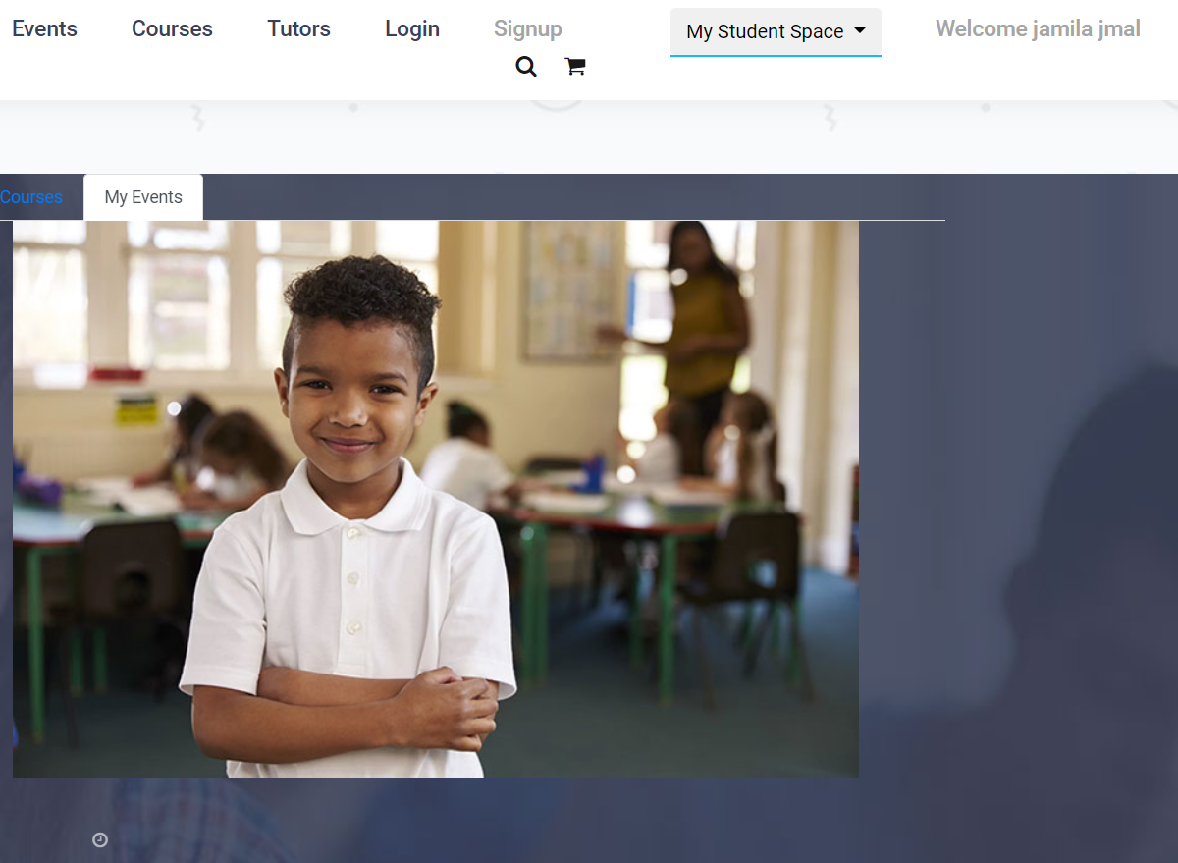
student

Slide 13
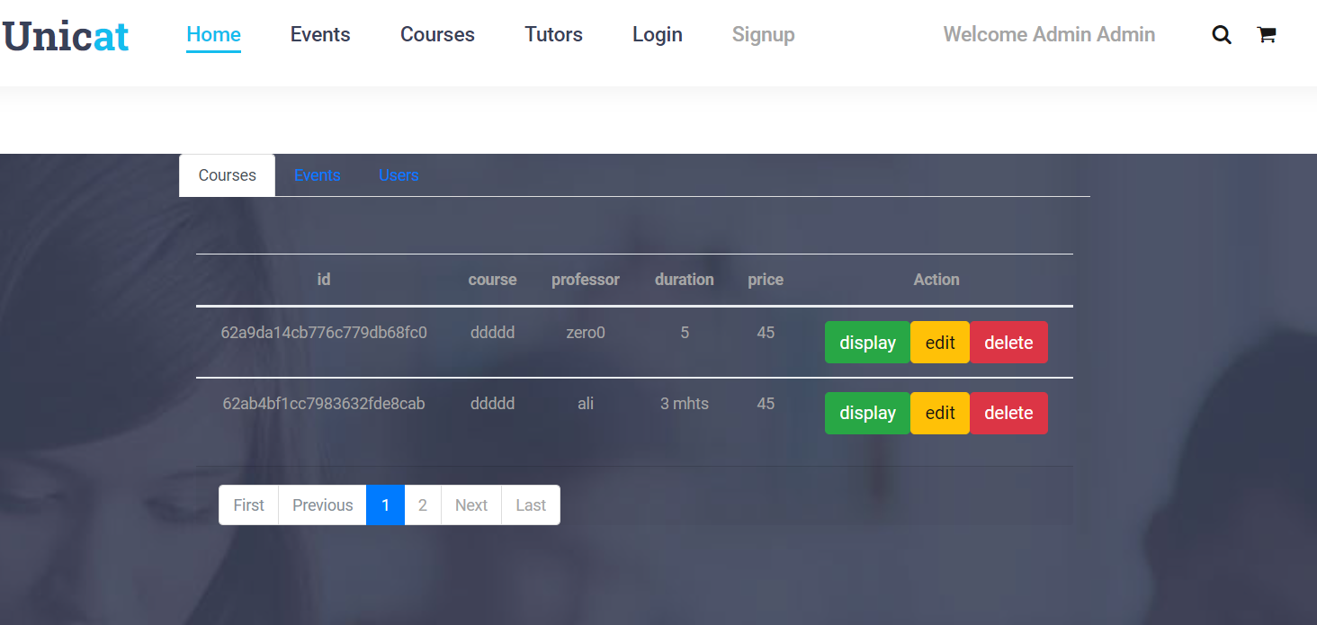
admin

Slide 14
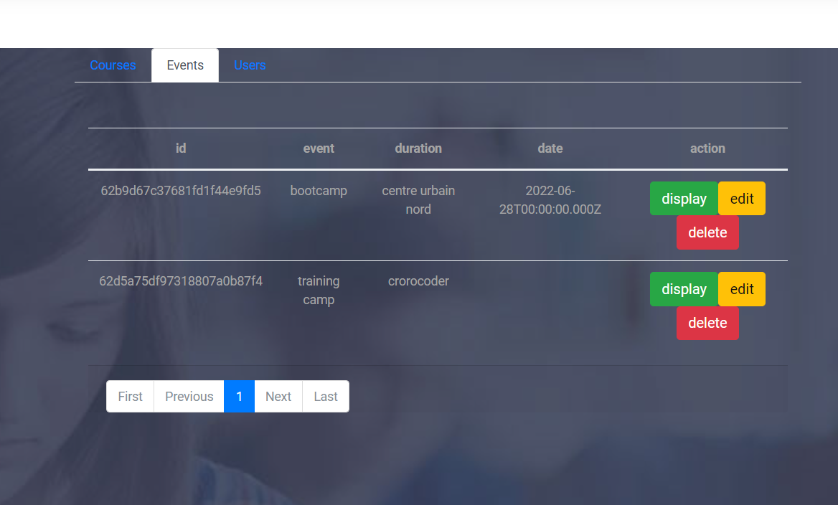
admin

Slide 15
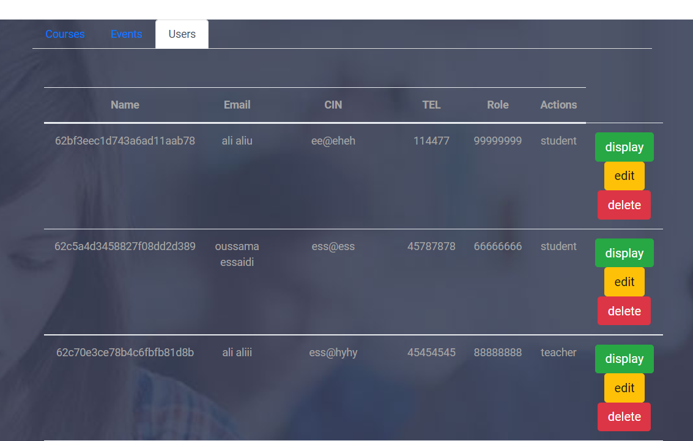
admin

Slide 16
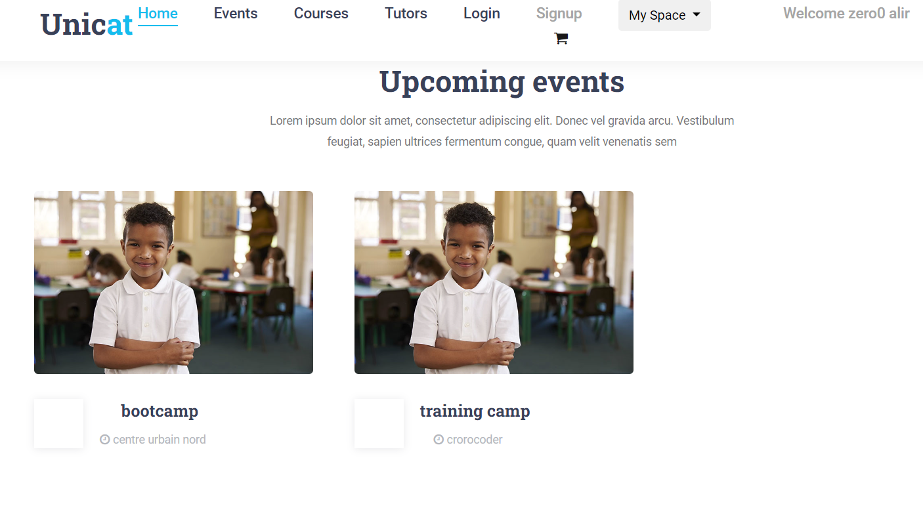
Events

Slide 17
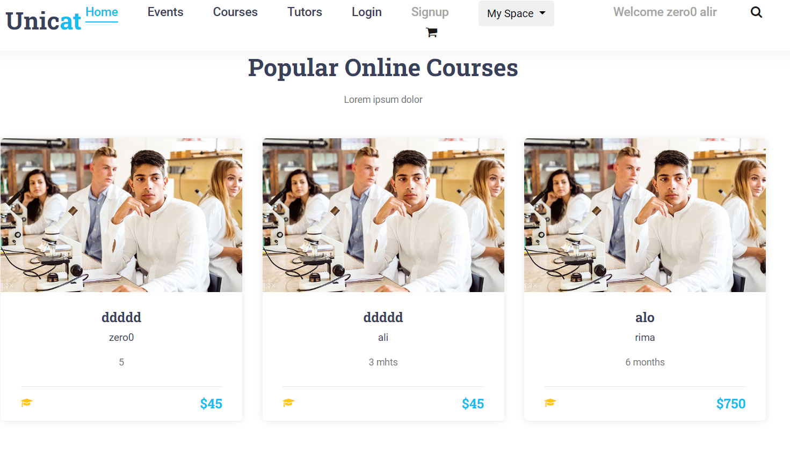
courses

Slide 18
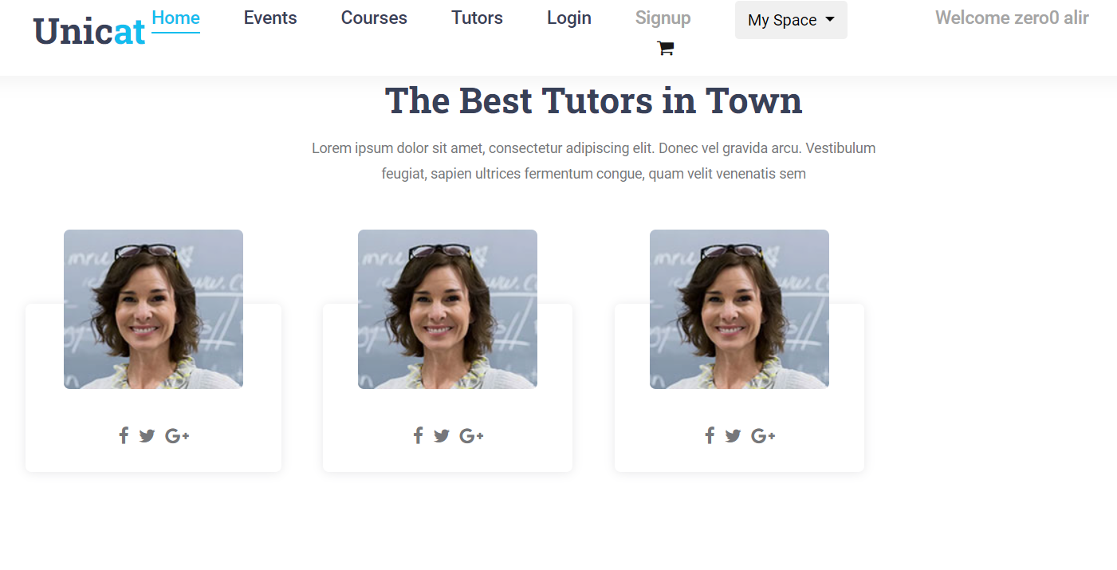
tutors

Slide 19

Thank you for your attention

